Slide 1

Embedded Servers
Spring Boot
Present: Nguyễn Văn A
Demo: Nguyễn Văn B
Collection: Nguyễn Văn C

Slide 2






Embedded Servers
1
Spring Boot
Which Embedded web servers does spring boot support?
Concepts and advantages of each embedded web servers?
If there isn’t Spring Boot, how to run tomcat server?
Demo.
  Start Tomcat server by Spring Boot.
  Start Tomcat server not use Spring Boot.
Spring Web
Apache Tomcat
Spring Boot
Spring Webflux
2
Notes:
Spring boot :

Slide 3
Concepts
2a
Spring Boot
Which Embedded web servers does spring boot support?
Concepts and advantages of each embedded web servers?
If there isn’t Spring Boot, how to run tomcat server?
Demo.
  Start Tomcat server by Spring Boot.
  Start Tomcat server not use Spring Boot.
Apache Tomcat
HTTP/Web server.
Java Servlet Conatiner
Opensource(Apache License). Foundation Apache Software foundation
Implement from JSP and Java Servlet
Java-base
HTTP/Web Server.
Java Servlet Container
Open Source(Apache/ Eclipse License)
Java-based.
HTTP/Web Server.
Java-based
Providing both blocking and non-blocking API’s
Opensource(Apache License). It is sponsored by Jboss.
A NIO client server framework
Enables quick and easy development of network applications.
Greatly simplifies and program streamlines networking such as TCP and UDP socket server.
3

Slide 4
Advantages
2b
Spring Boot
Which Embedded web servers does spring boot support?
Concepts and advantages of each embedded web servers?
If there isn’t Spring Boot, how to run tomcat server?
Demo.
  Start Tomcat server by Spring Boot.
  Start Tomcat server not use Spring Boot.
Apache Tomcat
Highly Flexible
Stable
Security
Most widely used Java application server
Very well documented with strong developer community.
Uses less memory
Fast servlet performance
App server scalability
Can be embedded with ease in java web application.
Fastest performance
Embeddable
Flexible
build a web server by combining small single purpose handlers
Well-documented Javadoc, user guide and examples
Less resource consumption
Minimized unnecessary memory copy
Complete SSL/TLS and StartTLS support
4

Slide 5


If there isn’t Spring Boot, how to deploy application tomcat server?
3
Spring Boot
Which Embedded web servers does spring boot support?
Concepts and advantages of each embedded web servers?
If there isn’t Spring Boot, how to run tomcat server?
Demo.
  Start Tomcat server by Spring Boot.
  Start Tomcat server not use Spring Boot.
Manual
Eclipse IDE
5

Slide 6
THANK YOU
Spring Boot

Slide 7
Sevlet là gì?
2
Spring Boot
☞
Là 1 interface được định nghĩa trong javax.servlet.
Which Embedded web servers does spring boot support?
Concepts and advantages of each embedded web servers?
If there isn’t Spring Boot, how to run tomcat server?
Demo.
  Start Tomcat server by Spring Boot.
  Start Tomcat server not use Spring Boot.
☞
Có 3 phương thức cần thực hiện cho một vòng đời của servlet
init()
destroy()
Servlet In Service
Service()
HTTP:
doGet(), doPost(), doHead(), doOptions(), doTrace(),…
7

Slide 8
Servlet containers
2
Spring Boot
Which Embedded web servers does spring boot support?
Concepts and advantages of each embedded web servers?
If there isn’t Spring Boot, how to run tomcat server?
Demo.
  Start Tomcat server by Spring Boot.
  Start Tomcat server not use Spring Boot.
Web Server
2.Forward Request
1.HTTP Request
1.HTTP Reqest
Servlet Container
3. Load Servlet
4. Initialization
6. HTTP Response
5. Process Request
8
Notes:
1. Máy chủ Web nhận HTTP request
2. Máy chủ Web chuyển tiếp yêu cầu tới servlet container
3. Servlet được lấy ra một cách tự động và tải lên địa chỉ không gian của container, nếu nó nằm trong container.
4. Container gọi init () method của servlet để khởi tạo (được gọi một lần khi servlet được load lần đầu tiên)
5. Container gọi service () method của servlet để xử lý HTTP request, tức là đọc dữ liệu trong yêu cầu và hình thành một response
6. Web server trả lại kết quả động đúng với vị trí yêu cầu

Slide 9

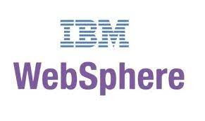


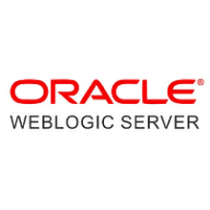

Java Servlet Containers
2
Spring Boot
Which Embedded web servers does spring boot support?
Concepts and advantages of each embedded web servers?
If there isn’t Spring Boot, how to run tomcat server?
Demo.
  Start Tomcat server by Spring Boot.
  Start Tomcat server not use Spring Boot.
GlassFish
Back
9

Slide 10
Build war file
3
Spring Boot
☞ Dynamic Web Application in Eclipse
Which Embedded web servers does spring boot support?
Concepts and advantages of each embedded web servers?
If there isn’t Spring Boot, how to run tomcat server?
Demo.
  Start Tomcat server by Spring Boot.
  Start Tomcat server not use Spring Boot.
Right click > Export > War file > Sestination Source
☞ Maven Web Application
mvn war:war
Back
10

Slide 11
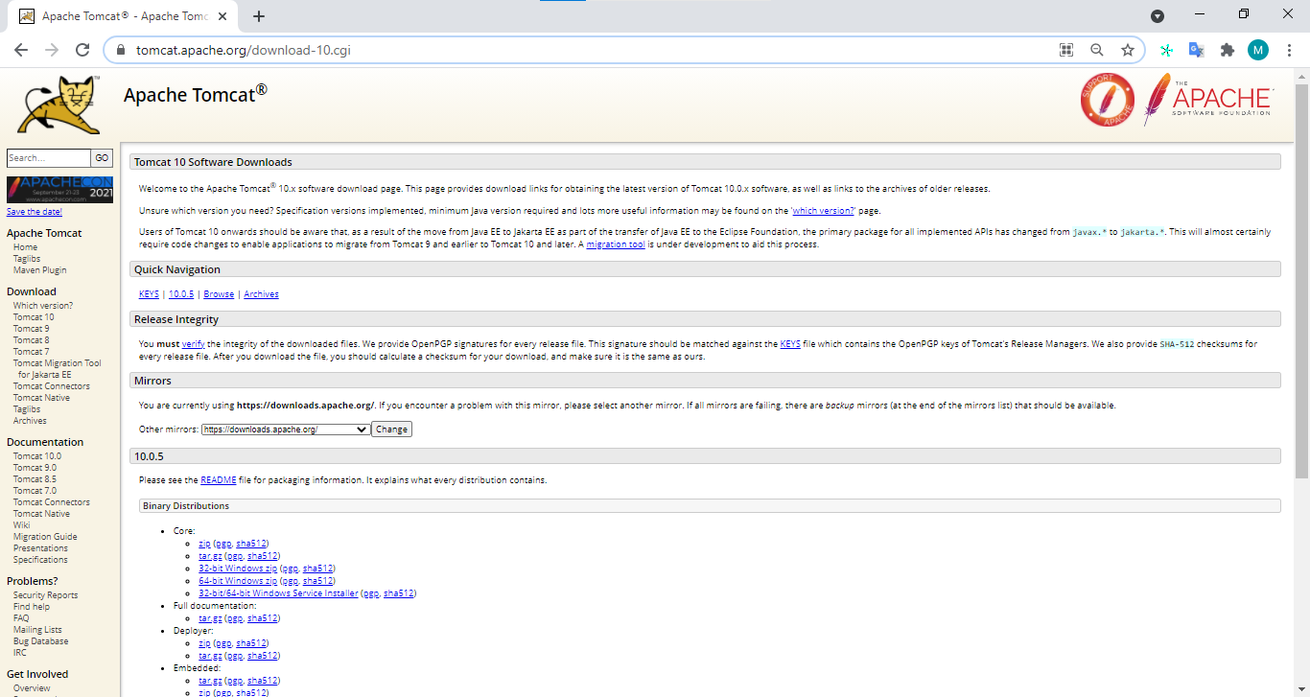
Download Tomcat
3
Spring Boot
Which Embedded web servers does spring boot support?
Concepts and advantages of each embedded web servers?
If there isn’t Spring Boot, how to run tomcat server?
Demo.
  Start Tomcat server by Spring Boot.
  Start Tomcat server not use Spring Boot.
B1: Download tomcat from https://tomcat.apache.org
11

Slide 12
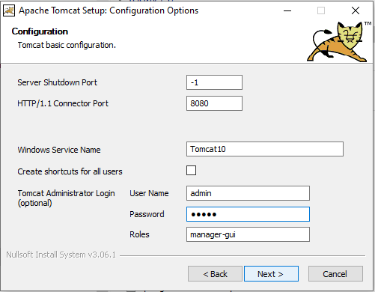
Install Tomcat
3
Spring Boot
Which Embedded web servers does spring boot support?
Concepts and advantages of each embedded web servers?
If there isn’t Spring Boot, how to run tomcat server?
Demo.
  Start Tomcat server by Spring Boot.
  Start Tomcat server not use Spring Boot.
B2: Install Tomcat
12

Slide 13
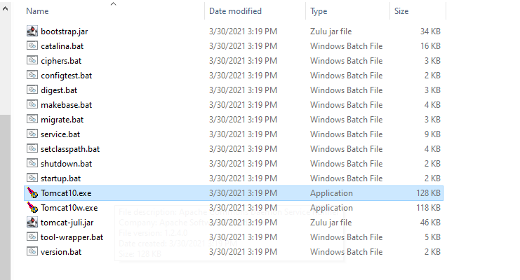
Start Tomcat
3
Spring Boot
Which Embedded web servers does spring boot support?
Concepts and advantages of each embedded web servers?
If there isn’t Spring Boot, how to run tomcat server?
Demo.
  Start Tomcat server by Spring Boot.
  Start Tomcat server not use Spring Boot.
B3: Start Tomcat
13

Slide 14
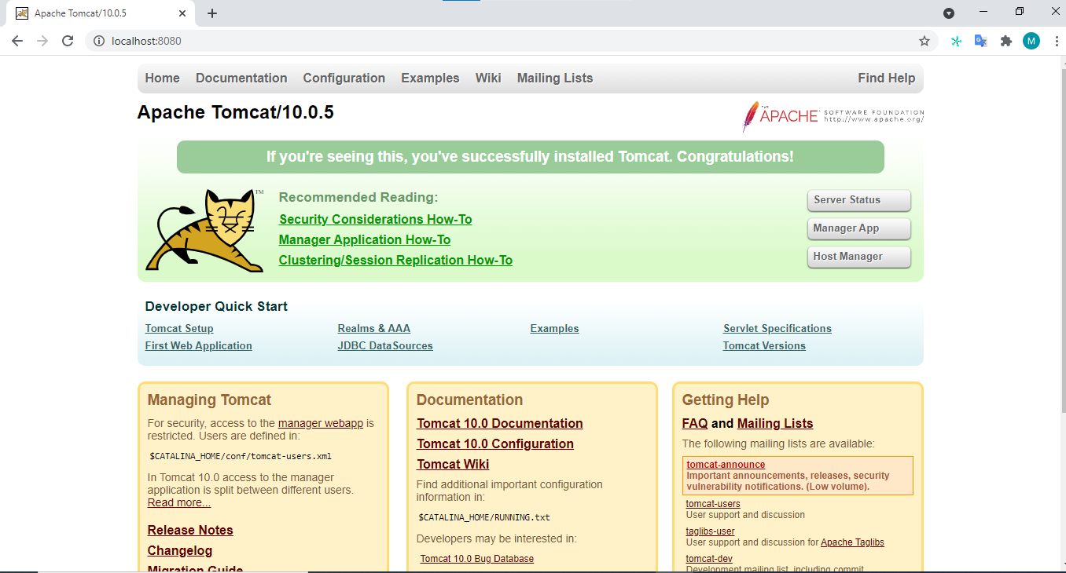
Deploy Project
3
Spring Boot
Which Embedded web servers does spring boot support?
Concepts and advantages of each embedded web servers?
If there isn’t Spring Boot, how to run tomcat server?
Demo.
  Start Tomcat server by Spring Boot.
  Start Tomcat server not use Spring Boot.
B4.1: Access localhost:8080
14

Slide 15
Deploy Project
3
Spring Boot
Which Embedded web servers does spring boot support?
Concepts and advantages of each embedded web servers?
If there isn’t Spring Boot, how to run tomcat server?
Demo.
  Start Tomcat server by Spring Boot.
  Start Tomcat server not use Spring Boot.
B4.2: Click Manager App
15

Slide 16
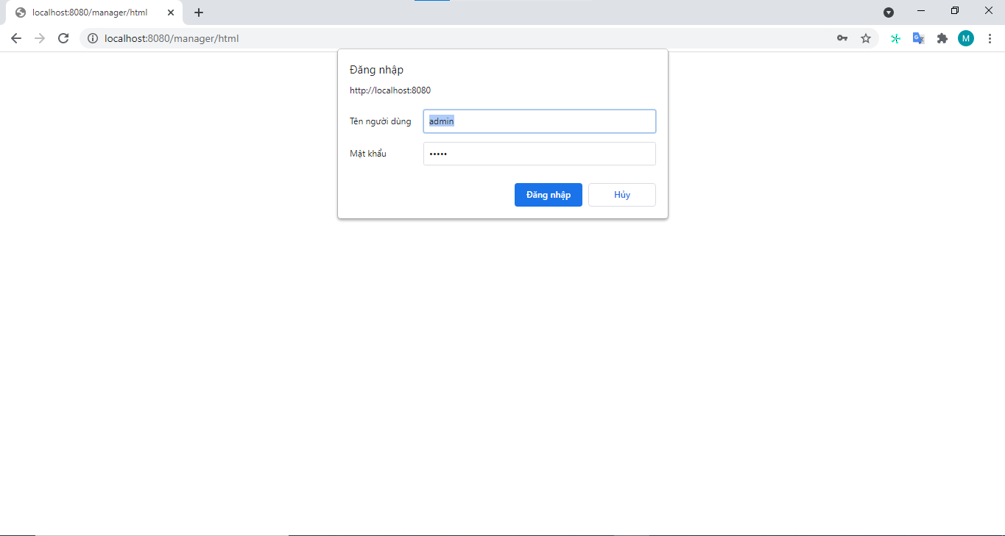
Deploy Project
3
Spring Boot
Which Embedded web servers does spring boot support?
Concepts and advantages of each embedded web servers?
If there isn’t Spring Boot, how to run tomcat server?
Demo.
  Start Tomcat server by Spring Boot.
  Start Tomcat server not use Spring Boot.
B4.3: Login
16

Slide 17
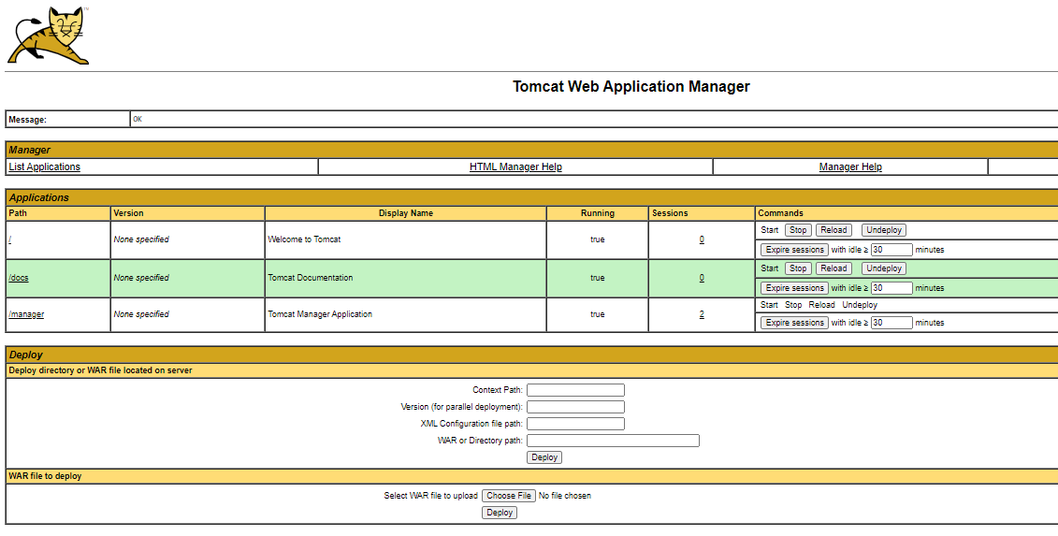
Deploy Project
3
Spring Boot
Which Embedded web servers does spring boot support?
Concepts and advantages of each embedded web servers?
If there isn’t Spring Boot, how to run tomcat server?
Demo.
  Start Tomcat server by Spring Boot.
  Start Tomcat server not use Spring Boot.
B4.4: Choose war file and press deploy
Back
17

Slide 18
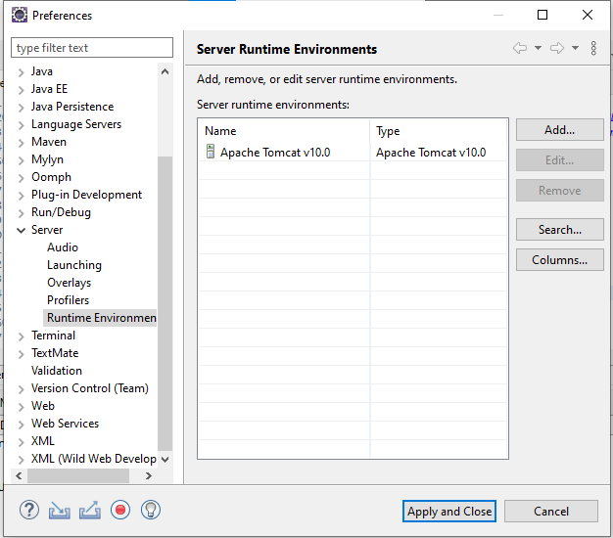
Add A New Server
3
Spring Boot
Which Embedded web servers does spring boot support?
Concepts and advantages of each embedded web servers?
If there isn’t Spring Boot, how to run tomcat server?
Demo.
  Start Tomcat server by Spring Boot.
  Start Tomcat server not use Spring Boot.
B1. Window > References > Server > Runtime Environment
18

Slide 19
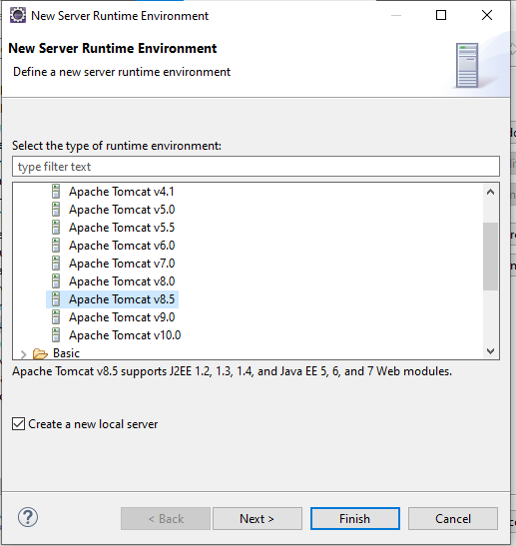
Add A New Server
3
Spring Boot
Which Embedded web servers does spring boot support?
Concepts and advantages of each embedded web servers?
If there isn’t Spring Boot, how to run tomcat server?
Demo.
  Start Tomcat server by Spring Boot.
  Start Tomcat server not use Spring Boot.
B2. Click Add button > choose tomcat server > Next
19

Slide 20
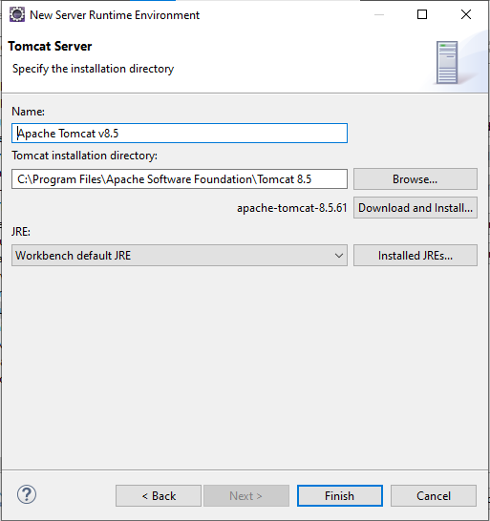
Add A New Server
3
Spring Boot
Which Embedded web servers does spring boot support?
Concepts and advantages of each embedded web servers?
If there isn’t Spring Boot, how to run tomcat server?
Demo.
  Start Tomcat server by Spring Boot.
  Start Tomcat server not use Spring Boot.
B3. Refer to home folder of Tomcat Server > Finish
20

Slide 21
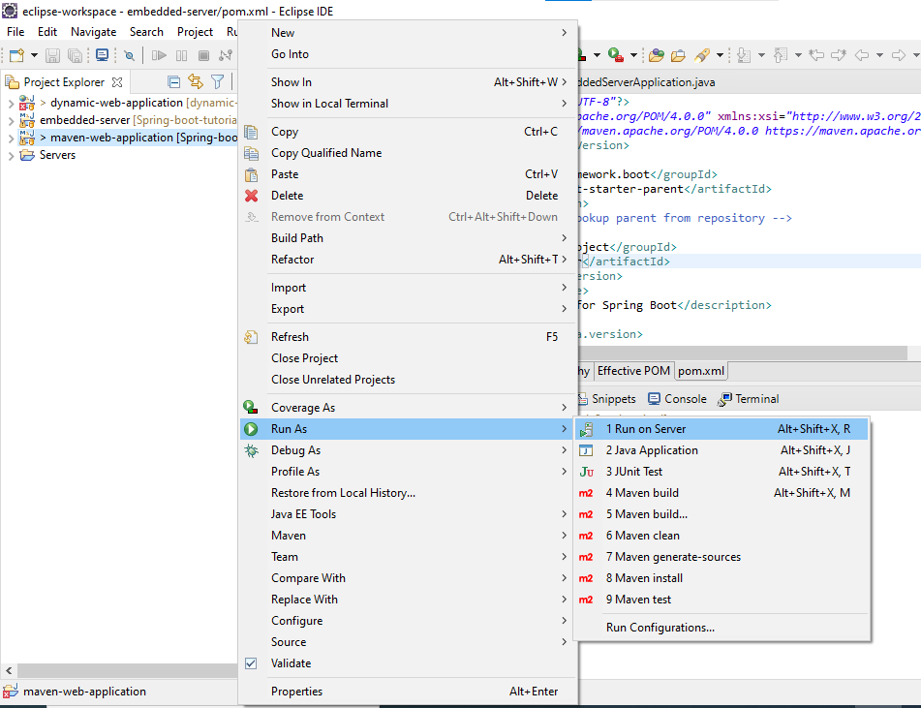
Run Web Application
3
Spring Boot
Which Embedded web servers does spring boot support?
Concepts and advantages of each embedded web servers?
If there isn’t Spring Boot, how to run tomcat server?
Demo.
  Start Tomcat server by Spring Boot.
  Start Tomcat server not use Spring Boot.
B4. Right Click to project > Run as > Run on Server
21

Slide 22
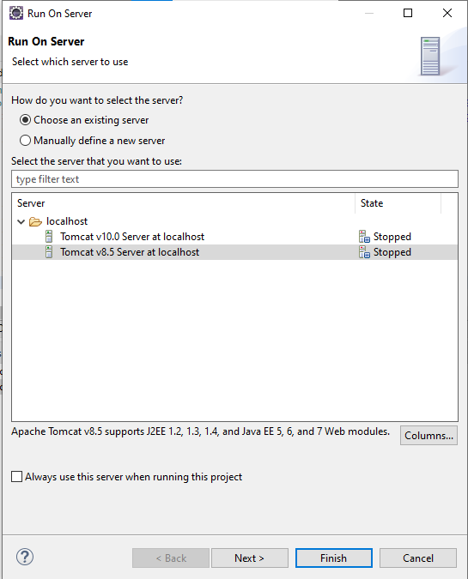
Run Web Application
3
Spring Boot
Which Embedded web servers does spring boot support?
Concepts and advantages of each embedded web servers?
If there isn’t Spring Boot, how to run tomcat server?
Demo.
  Start Tomcat server by Spring Boot.
  Start Tomcat server not use Spring Boot.
B5. Choose Tomcat Server and click finish
Back
22

